Slide 1




Case Study: Applications of deep learning in FinTech
- A Deep Learning Approach to Bank Direct Marketing
- Enhanced Recurrent Neural Network for Combining Static and Dynamic Features for Credit Card Default Prediction

Slide 2

Outline
Introduction to direct marketing
Direct marketing
Business analytic framework
Ranking v.s. classification
Lift, decile lift, and lift index
Case 1 – A Deep Learning Approach to Bank Direct Marketing
Case 2 – Enhanced Recurrent Neural Network for Combining Static and Dynamic Features for Credit Card Default Prediction
Conclusion
Notes:
Insurance payment

Slide 3
Introduction to direct marketing

Slide 4
Financial Technology (FinTech)
https://www.bloomberg.com/quicktake/financial-technology-companies-disrupt-comfy-banks-quicktake
Notes:
Insurance payment

Slide 5
Precision marketing –
Approaches
Classical methods
Customer segmentation
Customer relationship management (CRM) system
More data and deep learning models are available
https://medium.com/@r23456999/%E4%BD%95%E8%AC%82-artificial-neural-netwrok-33c546c94794
https://www.indiamart.com/proddetail/customer-relationship-management-software-17344820048.html
Notes:
Insurance payment

Slide 6

Marketing strategy –
Traditional marketing
From traditional marketing to direct marketing
Credit cards
Insurance
Loans
Funds
https://goo.gl/images/3fY58B
Notes:
Insurance payment

Slide 7
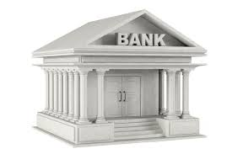

Marketing strategy –
Direct marketing
From traditional marketing to direct marketing
Customer information
Precision Marketing
Credit card
Insurance
Loans
Funds
Notes:
Insurance payment

Slide 8

Fast growth in rich
customer-level data
https://goo.gl/images/ZhZEHD
Notes:
Insurance payment

Slide 9
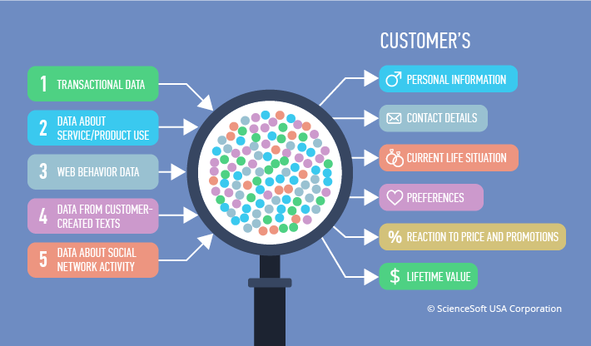
Precision marking based on
Big Data
https://goo.gl/images/ZXjBbe
Notes:
Insurance payment

Slide 10
Precision marketing
(direct marketing)
Propose appropriate items for certain customers at appropriate occasions
Increase acceptance rate
Improve customer satisfaction
Reduced costs
Why deep learning models are available to direct marketing?
Increasing amount of rich customer-level data
Data-driven direct marketing solution
Notes:
Insurance payment

Slide 11
Business analytic framework
Different from traditional machine/deep learning tasks
We need to define business goals and then translate them into appropriate analytic goals
https://www.educba.com/business-analytics-vs-predictive-analytics/
Notes:
Insurance payment

Slide 12
Business goal
This goal should be set in close collaboration with business partners to take care of their actual needs
Consider the following questions
What are the challenges and opportunities that they are interested in tackling?
What solutions they currently have in place?
What actions they can potentially take?
What are practical constraints, and the needed level of precision that is practically useful?
Notes:
Insurance payment

Slide 13
Business goal –
take FHC for example
Two opportunities for precision/direct marketing
Identify VIP customers
VIP are high-revenue-generating customers
Finding VIPs and performing marketing has the great potential to bring huge avenue
Identify suitable line of credits
Prevent transaction defaults
Customer credit scores
Notes:
Insurance payment

Slide 14
Analytic goal
Also known as data mining goal
Translate business goal into analytic goal
Specify the target column/feature
Based on the business and analytic goal, we select
Adequate performance measurements
Benchmark models
Adequate prediction model
Notes:
Insurance payment

Slide 15
Analytic goal –
Examples
Business goal
Identify potential positive VIP customers
Analytic goal
If the company perform another similar campaign, what is the probability that the customer responses positively? (classification)
Considering wrong campaign strategy brings negative customer satisfaction, what is the best portion of all customers that the company should first focus on? (ranking)
Notes:
Insurance payment

Slide 16
Classification v.s. ranking
Classification
Predict outcomes for all customers
Measuring the performance averaged among all customers
Ranking
Rank all customers from high potential to low potential
Aim to know what portion of the customer is most likely to response positively to the campaign
Performance metric: lift, lift index
Notes:
Insurance payment

Slide 17
Ranking problem and its
performance metric
Ranking is essential in FinTech applications
Campaign will only be sent to limited portion of customers aiming at reducing costs and/or improving customer satisfaction
Only the “top tier” customers are crucial
Use lift as performance evaluation metric which has intuitive meaning for marketing problems
How effectively we can “skim the cream” by selecting a relatively small number of cases and getting a relatively large portion of the responders
Notes:
Insurance payment

Slide 18
Lift and lift curve/chart
Lift in the top-n scoring customer is defined as
Answer the question: “How many portion of customer that received the campaign will response positively?”
Lift chart/curve can be created by plotting lift(n) as a function of n (normalized by the total number of the customers)
Also called gains chart
$$lift\left(n\right)= \frac{\# true buyers in the top−n scoring customers}{n}$$
Notes:
Insurance payment

Slide 19
Lift and lift curve/chart –
Example
If we perform campaign on the first 100 (20%) of the customers, we can retrieve 100 (20%) of the true buyers
X
https://www.quora.com/Whats-Lift-curve
Notes:
Insurance payment

Slide 20
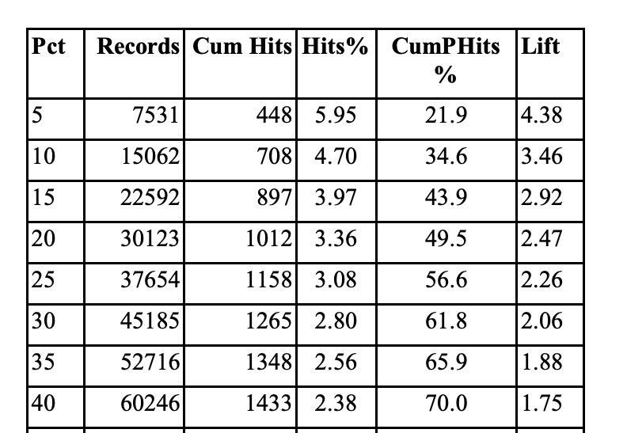
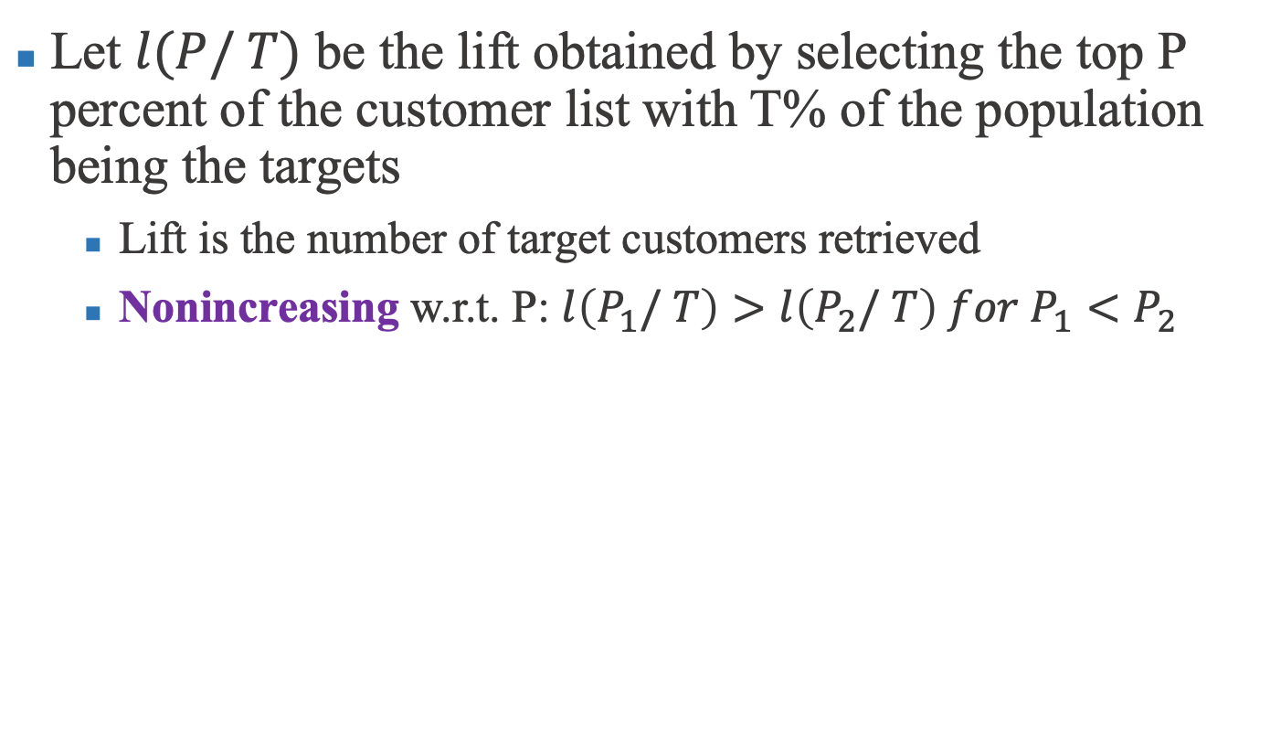
Lift index – Decile lift
Let $l(P/ T)$ be the lift obtained by selecting the top P percent of the customer list with T% of the population being the targets
Lift is the number of target customers retrieved
Nonincreasing w.r.t. P: $l\left(P_{1}/ T\right)>l\left(P_{2}/ T\right) for P_{1}<P_{2}$
http://citeseerx.ist.psu.edu/viewdoc/download?doi=10.1.1.683.710&rep=rep1&type=pdf
Notes:
Insurance payment

Slide 21
Lift index –
Step 1: counting true buyers
Sort customers with prediction scores
Decile: 10% of customers
Notes:
Insurance payment

Slide 22
Lift index –
Step 2: decile lifts
Decile lift: calculate the difference of true buyers between consecutive deciles then divided by the total amount of customers
Notes:
Insurance payment

Slide 23
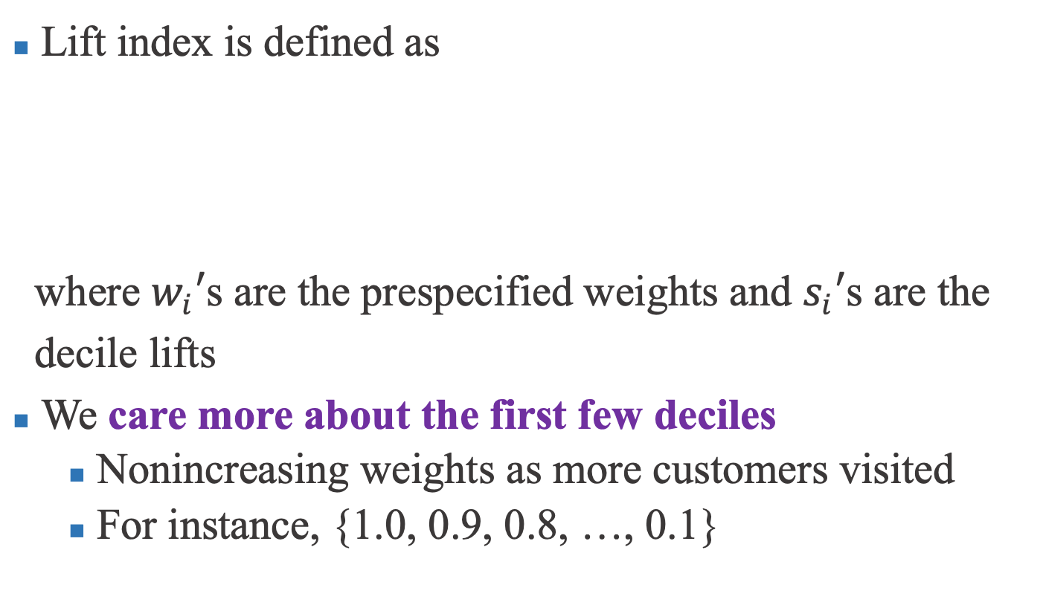
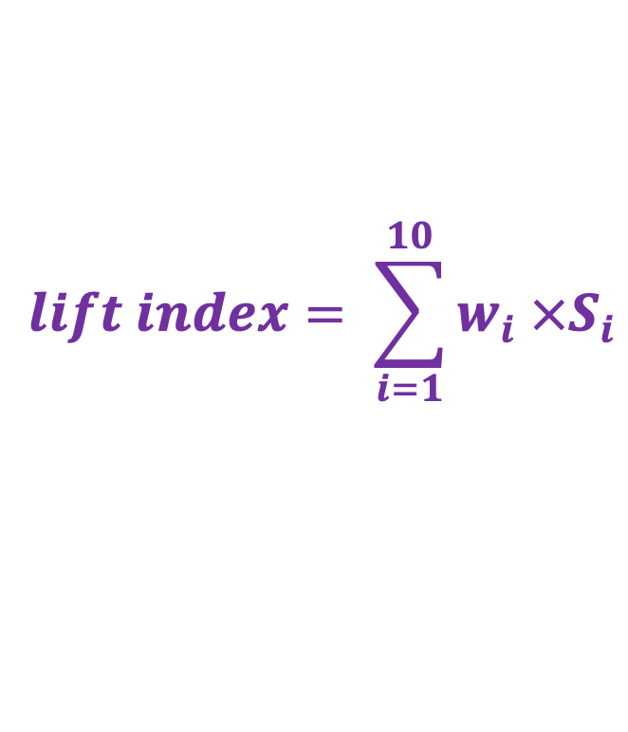
Lift index –
Step 3: lift index
Lift index is defined as
where $w_{i}′$s are the prespecified weights and $s_{i}′$s are the
decile lifts
We care more about the first few deciles
Nonincreasing weights as more customers visited
For instance, {1.0, 0.9, 0.8, …, 0.1}
$$lift index= \sum_{i=1}^{10}{w_{i} {×S}_{i}}$$
https://www.aaai.org/Papers/KDD/1998/KDD98-011.pdf
Notes:
Insurance payment

Slide 24
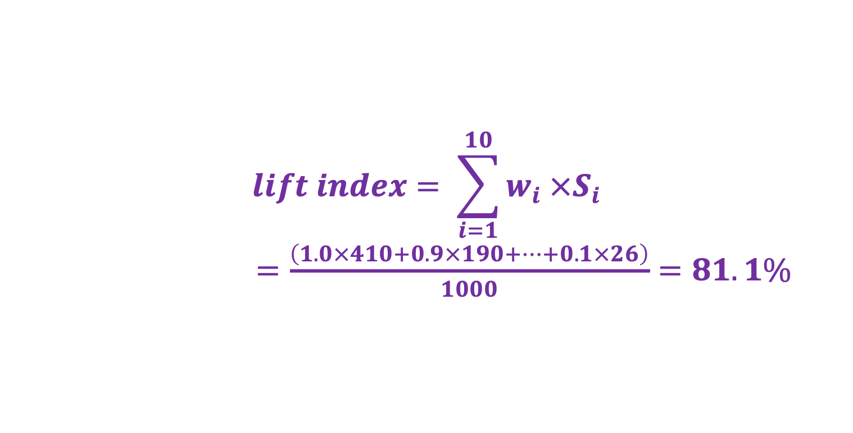
Lift index –
Example
Count the true buyers in each decile and find decile lifts
Compute lift index
10% | 20% | 30% | 40% | 50% | 60% | 70% | 80% | 90% | 100%
410 | 600 | 730 | 806 | 848 | 880 | 915 | 945 | 974 | 1000
410 | 190 | 130 | 76 | 42 | 32 | 35 | 30 | 29 | 26
$$lift index= \sum_{i=1}^{10}{w_{i} {×S}_{i}}$$
$=\frac{\left(1.0×410+0.9×190+⋯+0.1×26\right)}{1000}=81.1\%$
https://www.aaai.org/Papers/KDD/1998/KDD98-011.pdf
Notes:
Insurance payment

Slide 25
A Deep Learning Approach to Bank Direct Marketing
Te-Cheng Hsu, Jia-Siang Chen, Wei-Zhu Chen, Yu-Hsuan Chien,
Sz-Wei Wu, Mahsa Ashouri, Che Lin, Galit Shmueli
Published in 2018 INFORMS International Conference June, 17-20 @Taipei, Taiwan

Slide 26
A Deep Learning Approach
to Bank Direct Marketing
Introduce deep learning models into predicting potential positive customer during bank marketing campaign
Prediction model with practical business and analytic goals
Our model achieved a lift index of 91.76%, which is comparable to random forest (92.03%) and better than naïve Bayes (80.89%) and logistic regression (89.72%)
Notes:
Insurance payment

Slide 27
Motivation
Fast accumulating customer data have become the most valuable asset of financial holding companies (FHCs)
Customer behavioral data are considered essential to direct marketing
We can only send out offers to a limited set of customers while nonpositive recommendations lead to reduced revenue and customer satisfaction
Lift as performance evaluation metric
Ranking problem
Notes:
Insurance payment

Slide 28
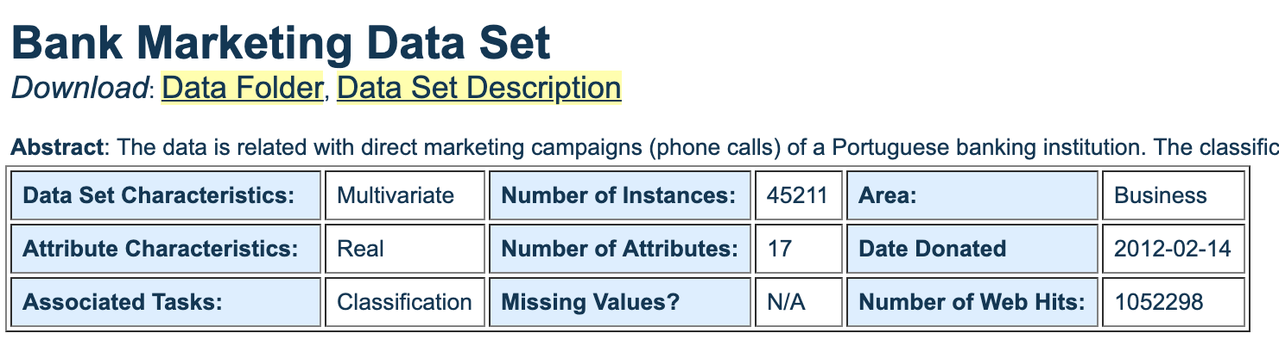
Bank marketing dataset –
Dataset overview
Direct marketing campaigns of a Portuguese banking institution based on phone calls
45,211 customers; 16/20 input features and 1 output variable (different versions are available)
https://archive.ics.uci.edu/ml/datasets/Bank+Marketing
Notes:
Insurance payment

Slide 29
Bank marketing dataset –
Input features (1/4)
Bank client data
age (numeric)
job: type of job (admin./blue-collar/entrepreneur/housemaid/ management/retired/self-employed/services/student/ technician/unemployed/unknown)
marital: marital status (divorced/married/single/unknown)
education (basic.4y/basic.6y/basic.9y/high.school/ illiterate/professional.course/university.degree/unknown)
default: has credit in default? (no/yes/unknown)
housing: has housing loan? (no/yes/unknown)
loan: has personal loan? (no/yes/unknown)
https://archive.ics.uci.edu/ml/datasets/Bank+Marketing
Notes:
Insurance payment

Slide 30
Bank marketing dataset –
Input features (2/4)
Related to last contact of the current campaign
contact: contact communication type (cellular/telephone)
month: last contact month of year (jan/ feb/ mar/ .../ nov/ dec)
day_of_week: last contact day of the week (mon/tue/wed/thu/fri)
duration: last contact duration in seconds (numeric) (actually NOT used in building model since if y=0 then y=‘no’)
https://archive.ics.uci.edu/ml/datasets/Bank+Marketing
Notes:
Insurance payment

Slide 31
Bank marketing dataset –
Input features (3/4)
Other attributes
campaign: number of contacts performed during this campaign and for this client (numeric, includes last contact)
pdays: number of days that passed by after the client was last contacted from a previous campaign (numeric; 999 means client was not previously contacted)
previous: number of contacts performed before this campaign and for this client (numeric)
poutcome: outcome of the previous marketing campaign (failure/nonexistent/success)
https://archive.ics.uci.edu/ml/datasets/Bank+Marketing
Notes:
Insurance payment

Slide 32
Bank marketing dataset –
Input features (4/4)
Social and economic context attributes
emp.var.rate: employment variation rate - quarterly indicator (numeric)
cons.price.idx: consumer price index - monthly indicator (numeric)
cons.conf.idx: consumer confidence index - monthly indicator (numeric)
euribor3m: euribor 3 month rate - daily indicator (numeric)
nr.employed: number of employees - quarterly indicator (numeric)
https://archive.ics.uci.edu/ml/datasets/Bank+Marketing
Notes:
Insurance payment

Slide 33
Bank marketing dataset –
Business and analytic goals
Potential business goal
Find the customer the customers that will subscribe to the financial product being marketed (term deposit) given their financial behavior and demographic information and previous campaign outcomes
Improve marketing effectiveness by targeting the right customers
Data mining goal
Predict whether a certain customer will subscribe to a term deposit or not
Binary classification problem
Notes:
Insurance payment

Slide 34
Bank marketing dataset –
Performance evaluation metrics
Typical binary classification problems
F1-score, ROC, AUC
To genuinely meet practical direct marketing application goals
Will only conduct marketing to a small subset of customers
We are also interested in accurately predicting the true buyers among top-tier customers
Ranking problem => lift & lift index
Notes:
Insurance payment

Slide 35
Class imbalance
Different number of samples for each class
Consider a predictor always outputs class 1 as prediction
https://towardsdatascience.com/handling-imbalanced-datasets-in-machine-learning-7a0e84220f28
Notes:
Insurance payment

Slide 36
Class imbalance –
Undersampling
Undersampling reduces the number of samples in majority class
At the cost of dropping precious data
https://towardsdatascience.com/sampling-techniques-for-extremely-imbalanced-data-part-i-under-sampling-a8dbc3d8d6d8
Notes:
Insurance payment

Slide 37
Class imbalance –
Oversampling
Two types
Generate synthetic minority class samples (SMOTE)
Repeatedly draw samples from minority class samples with replacement
https://shahinrostami.com/posts/machine-learning/preprocessing-structured-data/class-imbalance-and-oversampling/
Notes:
Insurance payment

Slide 38
Synthetic Minority Oversampling
TEchnique (SMOTE)
SMOTE is widely-used to tackle class imbalance
Generate synthetic samples for minority class via interpolation
https://www.kaggle.com/residentmario/oversampling-with-smote-and-adasyn
Notes:
Insurance payment

Slide 39
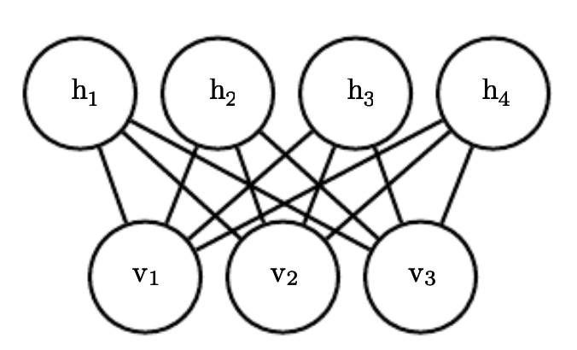
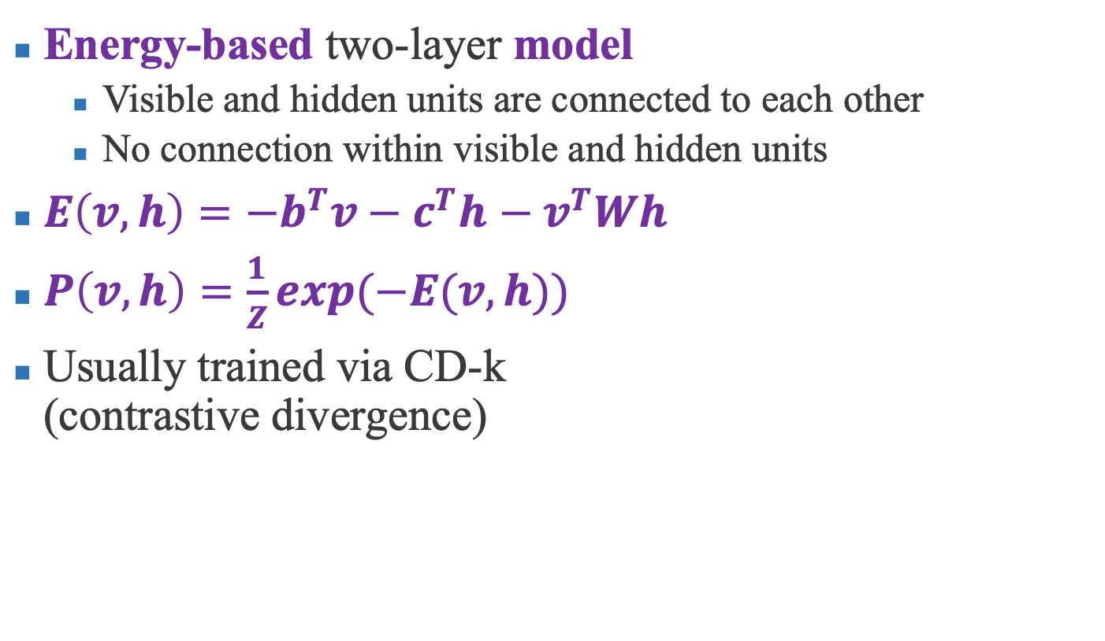
Restricted Boltzmann
machine (RBM)
Energy-based two-layer model
Visible and hidden units are connected to each other
No connection within visible and hidden units
$E\left(v,h\right)=−b^{T}v−c^{T}h$ $− v^{T}Wh$
$P\left(v,h\right)=\frac{1}{Z}exp⁡(−E(v,h))$
Usually trained via CD-k (contrastive divergence)
http://www.deeplearningbook.org/contents/generative_models.html
Notes:
Insurance payment

Slide 40
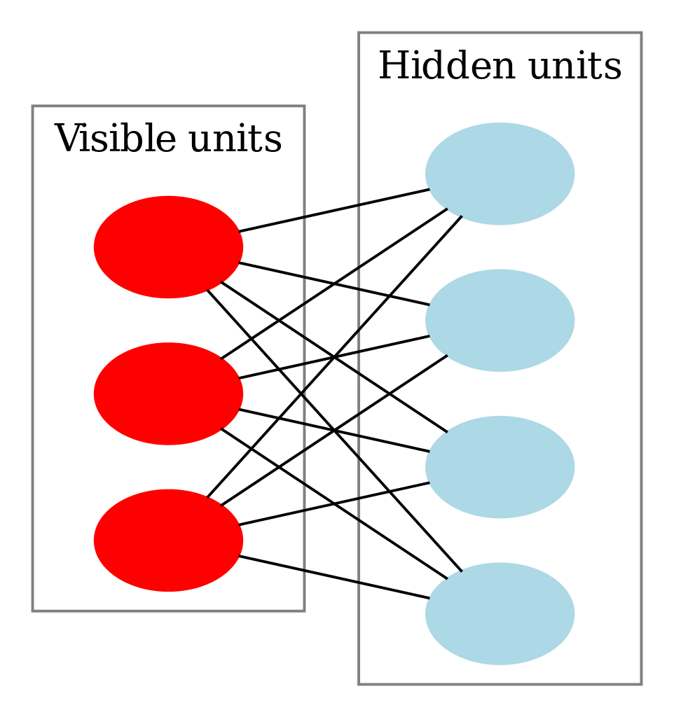
RBM as network pre-training
Propose to use pre-trained RBM as the first layer of our neural network (unsupervised pre-training)
Utilizing the feature extraction ability of RBM
Better than start training from random
RBM Feature extraction + DNN classifier => final prediction
Neural
Network
https://zh.wikipedia.org/wiki/%E5%8F%97%E9%99%90%E7%8E%BB%E5%B0%94%E5%85%B9%E6%9B%BC%E6%9C%BA
Notes:
Insurance payment

Slide 41
Experimental details
Categorical variables were transformed into one-hot vectors using dummies and all columns were standardizing using the training set distribution
Apply SMOTE on training set to tackle class imbalance problem whereas validation and test sets were kept intact
60% training + 10% validation + 30% testing
Apply L2-regularization
Hyper-parameters were selected by selecting the smallest error rate model on validation set
Benchmark models: naïve Bayes, LR, and RF
Notes:
Insurance payment

Slide 42
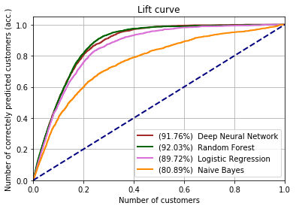
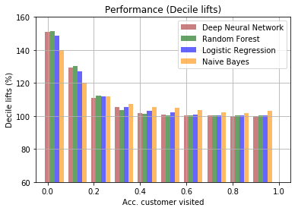
Proposed model provides
accurate prediction
50% improvement over traditional marketing
Notes:
Insurance payment

Slide 43
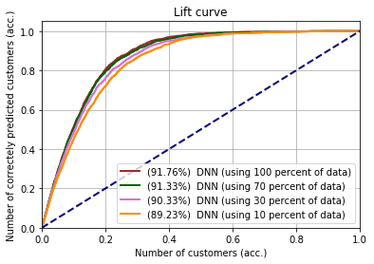
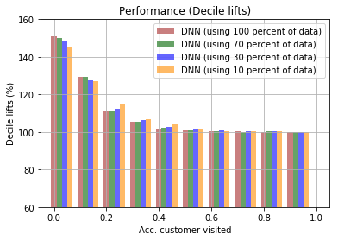
With increasing available data
3% improvement in lift index from 10% to 100 data
DNN model has the potential to outperform RF
Notes:
Insurance payment

Slide 44
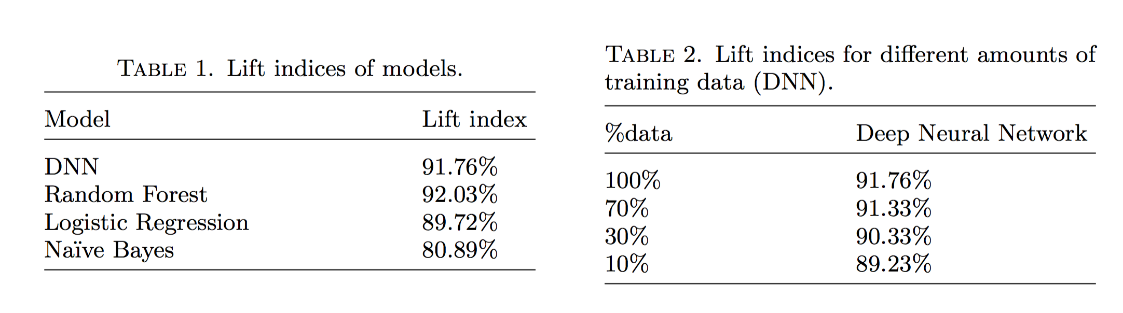
Performance summary
50% improvement over traditional marketing
DNN performs better with more data
Notes:
Insurance payment

Slide 45
Future work
Pre-training DNN with RBM greatly improves performance
Pre-training with deeper architecture (full network)
Deep Boltzmann Machine (DBM)
Deep Belief Network (DBN)
Transfer learning or prior information
Boostrapping and ensemble
Notes:
Insurance payment

Slide 46
Conclusion
DNN-based model for direct marketing with lift index as evaluation metric where customers are ranked by probabilities from our model to ensure that most of the true buyers are recalled
We show that the DNN model can be fit into a business analytics framework
Our model achieved a lift index of 91.76%, which is comparable to random forest (92.03%) and better than naïve Bayes (80.89%) and logistic regression (89.72%)
Notes:
Insurance payment

Slide 47
Enhanced Recurrent Neural Network for Combining Static and Dynamic Features for Credit Card Default Prediction
Te-Cheng Hsu, Shing-Tzuo Liou, Yun-Ping Wang, Yung-Shun Huang, Che-Lin
Published in 2019 ICASSP
12 – 17, May, 2019 @ Brighton, UK

Slide 48
Enhanced Recurrent Neural Network
for Combining Static and Dynamic Features
for Credit Card Default Prediction
Learn a RNN dynamic feature extractor with GRU on credit payment history and combined with other static features to predict credit card defaults
Our model (RNN-RF) achieved a lift index of 0.659 which is better than other benchmark models
Notes:
Insurance payment

Slide 49
Motivation
Fast growing customer-level financial data makes it possible to incorporate big data analytics into building intelligent decision-making systems
Combine RF and RNN to fully exploit both dynamic and static features
RNNs are specifically designed to use recursive architecture to extract patterns from input sequences
RF is well-known for its superior performance; however, time dependency in data are dropped
Notes:
Insurance payment

Slide 50
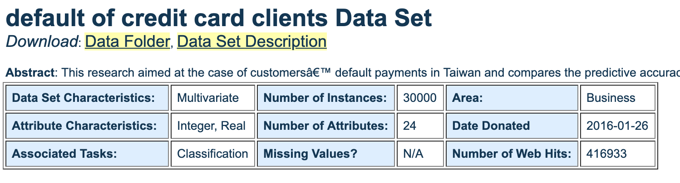
Default of credit card client dataset
Related to default payments in Taiwan
30/000 customers; 23 input features and 1 output variable
https://archive.ics.uci.edu/ml/datasets/default+of+credit+card+clients
Notes:
Insurance payment

Slide 51
Default of credit card client dataset –
Input features (1/2)
Demographic information (static features)
Amount of the given credit (numeric, NT dollar) It includes both the individual consumer credit and his/her family (supplementary) credit
Gender (1 = male; 2 = female)
Education (1 = graduate school; 2 = university; 3 = high school; 4 = others)
Marital status (1 = married; 2 = single; 3 = others)
Age (numeric, year)
Notes:
Insurance payment

Slide 52
Default of credit card client dataset –
Input features (2/2)
History/Amount of past payment; bill statement
History of past payment (repayment status)
Amount of bill statement (NT dollar)
Amount of previous payment (amount paid)
From April to September, 2015 (6 months)
Notes:
Insurance payment

Slide 53
Business and analytic goals
Potential business goal
Prevent default payments by lowering risky customers credit amounts
Prevent default payments by supervising risky customers
Corresponding analytic goal
Predict whether a customer will default on next payment
Binary classification problem
Notes:
Insurance payment

Slide 54
Performance evaluation metrics
Binary classification problem
ROC, AUC, ACC
Ranking problem
Lift curve, lift index
Notes:
Insurance payment

Slide 55
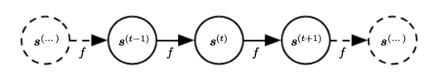
Recurrent neural network (RNN) –
Basic ideas
A specific type of neural network for sequential data
Recurrent: the state of the network at time t refers back to the same definition at time t-1
Parameter sharing (stationary assumption)
The same function f at each time step: better generalization for different sequence lengths & positions in time
http://www.deeplearningbook.org/contents/rnn.html
Notes:
Insurance payment

Slide 56
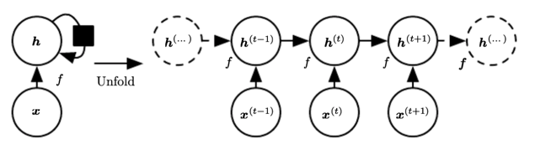
Recurrent neural network (RNN) –
Unfolding RNN
http://www.deeplearningbook.org/contents/rnn.html
Notes:
Insurance payment

Slide 57
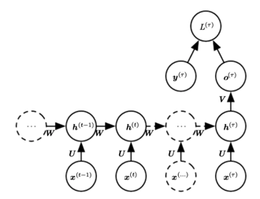
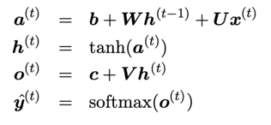
Recurrent neural network (RNN) –
Detailed explanation
function applied to all time steps
in RNN basic cells
loss function
http://www.deeplearningbook.org/contents/rnn.html
Notes:
Insurance payment

Slide 58
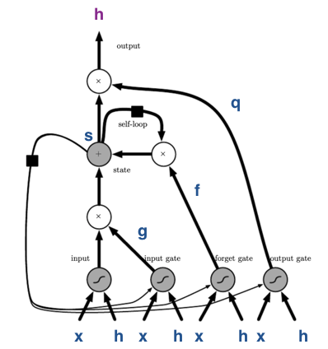
Long-Short Term Memory (LSTM) –
Structure
http://www.deeplearningbook.org/contents/rnn.html
Notes:
Insurance payment

Slide 59
Long-Short Term Memory (LSTM) –
Gates
forget gate
internal state
input gate
output gate
http://www.deeplearningbook.org/contents/rnn.html
Notes:
Insurance payment

Slide 60
Gated Recurrent Unit (GRU)
update gate
reset gate
http://www.deeplearningbook.org/contents/rnn.html
Notes:
Insurance payment

Slide 61
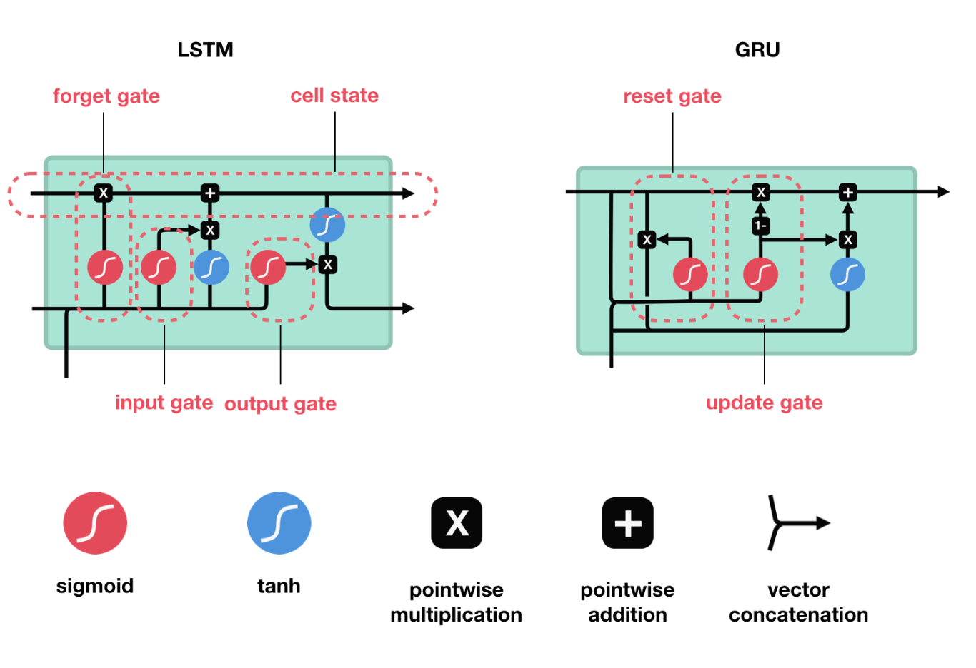
Comparison: LSTM v.s. GRU
https://towardsdatascience.com/illustrated-guide-to-lstms-and-gru-s-a-step-by-step-explanation-44e9eb85bf21
Notes:
Insurance payment

Slide 62
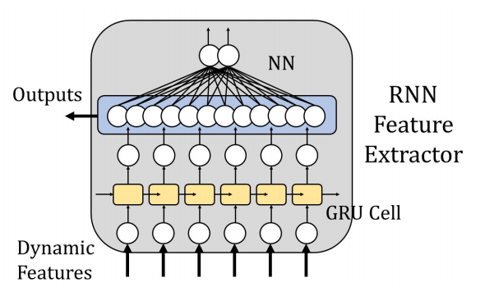
Model design strategies --
Dynamic features
Since RNN excels at extracting features from sequence data, we utilized payment history to pre-train the network
Pre-trained RNN acted as a dynamic feature extractor
Notes:
Insurance payment

Slide 63
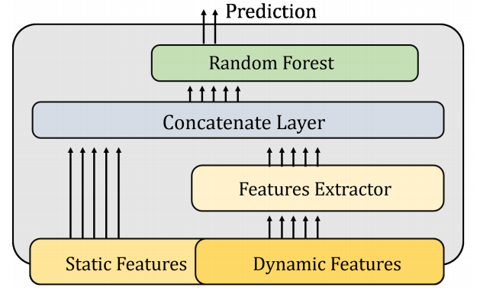
Model design strategies –
Static features
Static features were concatenated with extracted dynamic features and then fed into a classifier to made the final prediction
Notes:
Insurance payment

Slide 64
Model design strategies –
Concatenation
Through experiments, we found that using GRU cells in RNN and combine both types of features with RF provides the best results
Notes:
Insurance payment

Slide 65
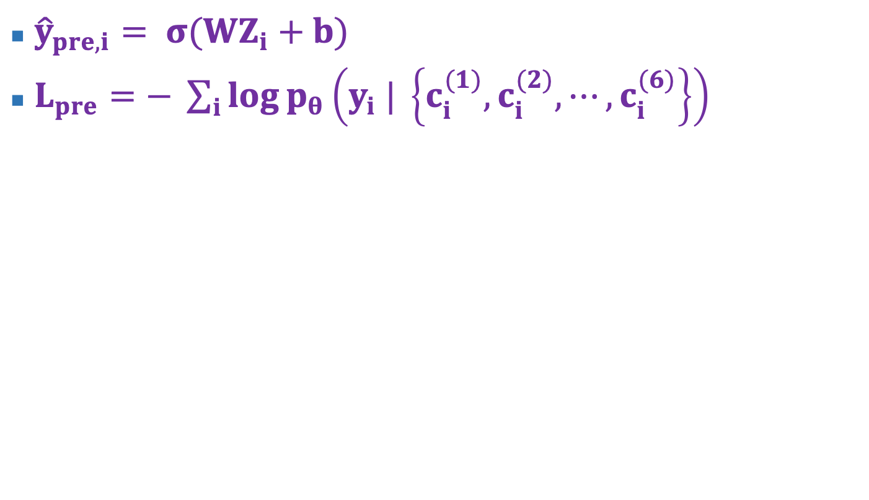
Enhanced RNN (RNN-RF) –
Dynamic feature extractor
${\hat{y}}_{pre,i}= σ(WZ_{i}+b)$
$L_{pre}=− \sum_{i}{\log{p_{θ}\left(y_{i} | \left\{c_{i}^{(1)},c_{i}^{(2)}, ⋯,c_{i}^{(6)}\right\}\right)}}$
y
Z
c
Notes:
Insurance payment

Slide 66
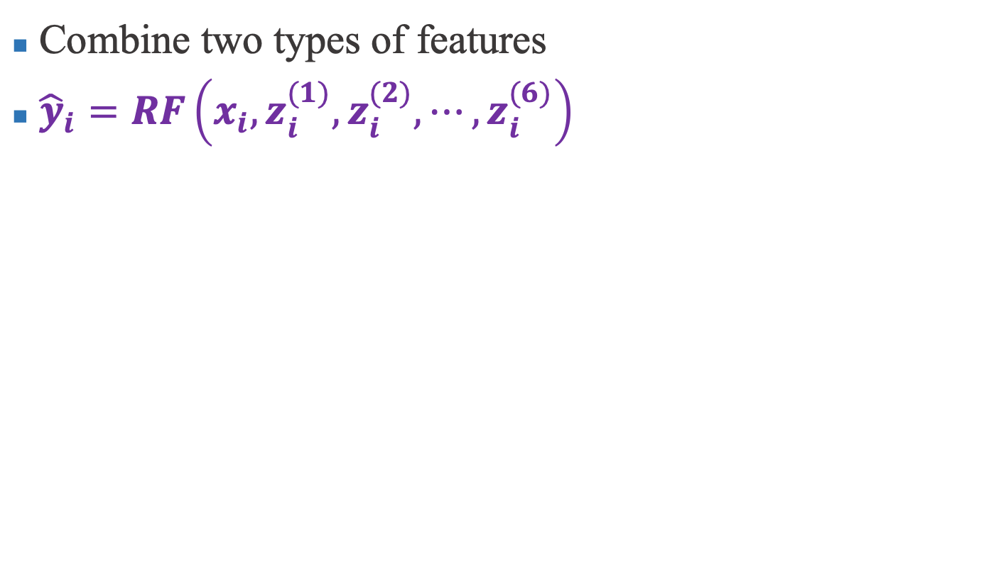
Enhanced RNN (RNN-RF) –
Concatenation
Combine two types of features
${\hat{y}}_{i}=RF\left(x_{i},z_{i}^{(1)},z_{i}^{(2)}, ⋯,z_{i}^{(6)}\right)$
y
x
z
Notes:
Insurance payment

Slide 67
Experimental details
70% training + 30% testing
Applied SMOTE on the training set
Lift index weights = 1.0, 0.9, …, 0.1
All columns were standardized with training set distribution
Benchmark models: LR, KNN, SVM, RF
Notes:
Insurance payment

Slide 68
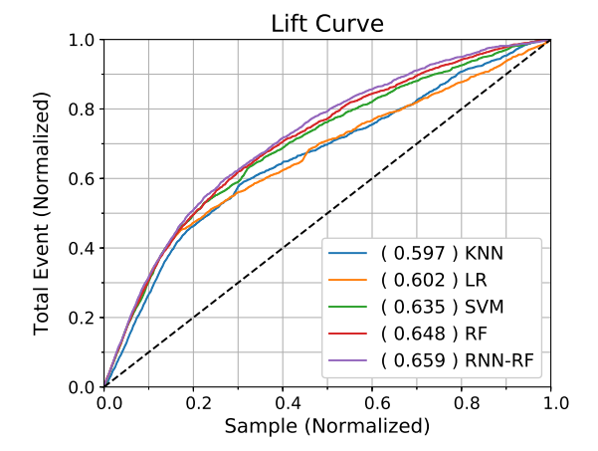
Accurate RNN-RF prediction
RNN-RF provides the best performance
Notes:
Insurance payment

Slide 69
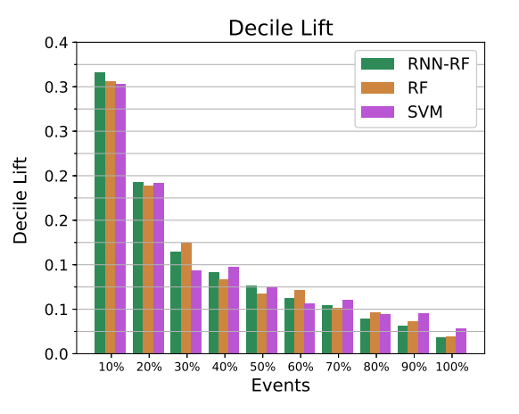
Accurate RNN-RF prediction
RNN-RF provides 30% improvement over traditional marketing
Notes:
Insurance payment

Slide 70
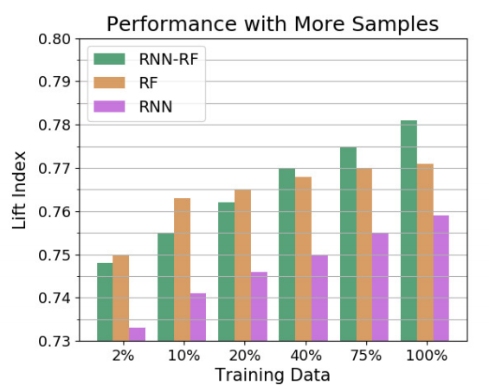
Improve when more data available
RNN-RF improved when more data available
RF kept rather unchanged
Notes:
Insurance payment

Slide 71
Conclusion and future work
Lift index genuinely express model ranking ability closely aligned to practical risk management activities
RNN-RF is the best performing model among benchmark models in both lift index and AUC
From our results/ we expect to achieve even better results when more data are available
Our model (RNN-RF) achieved a lift index of 0.659 which is better than other benchmark models
Notes:
Insurance payment

Slide 72
Conclusion

Slide 73
Conclusion
Lift index is an essential metric in direct marketing applications since we are dealing with ranking problems
Deep learning models proved to be useful in direct marketing and provided satisfactory performance
The more data available, the powerful the deep learning models are
Deep learning model is able to incorporate different types of data, which is not available for classical models
Deep learning models are of huge potential in FinTech applications and still waited to be discovered
Notes:
Insurance payment

Slide 74


Acknowledgements
The first work is a joint work done funded by MOST 3-year FinTech project
We thank Prof. G. Shmueli from Institute of Service Science, NTHU, for the business analytic insights and T.-C. Andy Hsu for organizing the slides

